Slide 1
DevOps, CodeBuild and Continuous Integration
CITS5503 Dr David Glance

Slide 2
What is DevOps?
Creating automation for the entire build/test/release cycle
Allows Development, Test and Production environments to be built, tested and deployed easily and systematically
Allows new components to be added automatically
Could be done manually with the help of scripts but there are software environments that manage remote communication and execution of resource creation, software installation and configuration

Slide 3
A simple approach: Fabric
Fabric allows for the remote execution of commands from Python
It is built on:
secure transport layer provided by SSH (remote shells and file transfer)
process execution
Code can be split into tasks and then run from the command line using ‘fab’
We can start by looking at components of Fabric - SSH

Slide 4
SSH
Defined in RFCs 4250-4254 OpenSSH is the version that is currently supported on Mac, Linux/Unix distributions and Windows
Provides cryptographic authentication and protection for communications between a client and an SSH server listening on port 22 (normally)
Client can authenticate the server using its public key fingerprint
Server can authenticate the client by checking that it has a matching private key to a public key held on the server (usually in ~/.ssh/authorized_keys

Slide 5
Key authentication
From Sebastien Suanier https://sebastien.saunier.me/blog/2015/05/10/github-public-key-authentication.html

Slide 6
SSH
Can login and execute remote commands:
ssh -i key.pem ubuntu@dnsname ls –al
Can copy files
scp -i key.pem localfile ubuntu@dnsname:/path/remotefile
Use ssh-keygen to generate public/private key pairs

Slide 7
Fabric
Install fabric using: pip install fabric
Use a config file in ~/.ssh to configure ssh configuration information (see lab)
Connecting and running commands
use connection.run(‘command’)
from fabric import Connection
c = Connection(‘host alias’)
# execute remote commands
result = c.run(‘ls -al’)
if c.run(‘test –f /opt/mydata/myfile’, warn=True).failed:
# do something for file not there
pass

Slide 8
Fabric (continued)
Copying files
use connection.put(localfilepath, remotefilepath)
Run as sudo
use connection.sudo(command, otherargs)
Can create commands for ‘fab’ using a fabfile.py

Slide 9
Fabfile
from fabric import Connection
from invoke import task
@task
def upload_and_unpack(c):
if c.run('test -f /opt/mydata/myfile', warn=True).failed:
c.put('myfiles.tgz', '/opt/mydata’)
c.run('tar -C /opt/mydata -xzvf /opt/mydata/myfiles.tgz’)
$ fab –list
Available tasks:
upload_and_unpack
$ fab –H <host alias> upload_and_unpack

Slide 10
AWS OpsWorks and Chef
There are many different environments and approaches
AWS OpsWorks uses Chef or Puppet (there are others like Ansible)
We will focus on Chef
Courtesy: RightScale http://docs.rightscale.com/st/chef-dev/how_does_rightscale_use_chef.html

Slide 11
Chef
Chef uses a client/server architecture
The details of what you want to configure are stored in “cookbooks”
A command called “knife” is used to create and manage cookbooks
Syntax of cookbooks is based on the language Ruby
Recipes
Resources
Attributes
Chef client – agent that runs on managed nodes responsible for:
Registering and authenticating node with Chef server
Synchronizing cookbooks
Enacting instructions
Handling exceptions
Ohai: tool that scans the node and returns system configuration data

Slide 12
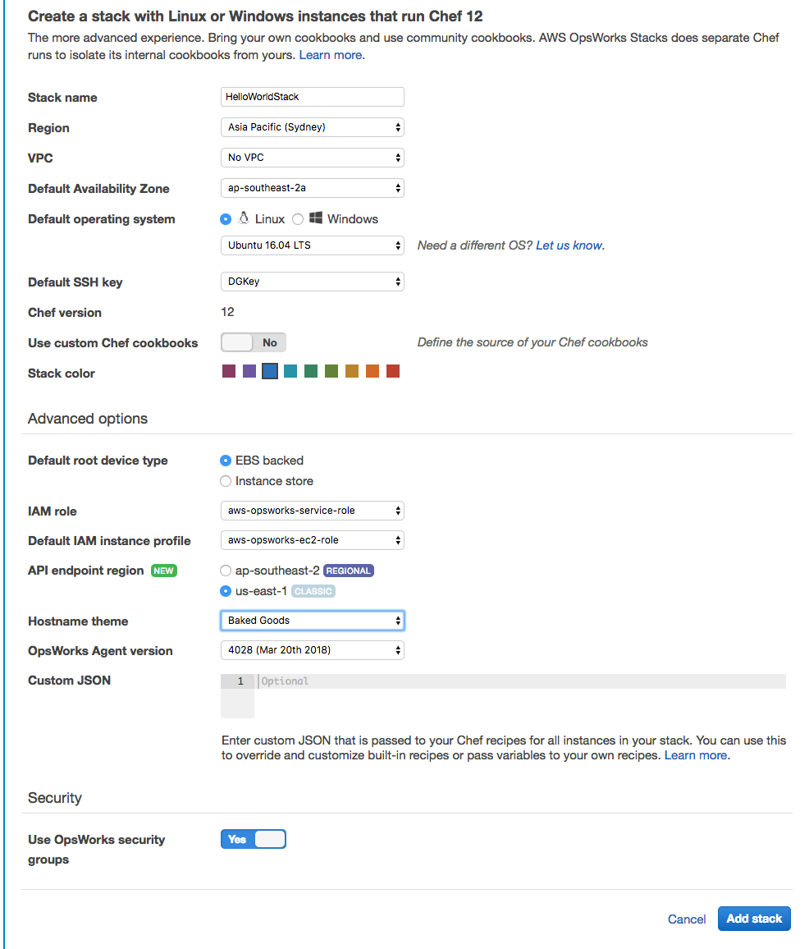
AWS OpsWorks Example
OpsWorks uses stacks, layers and applications
Add stack
need to set custom chef cookbooks
http repository https://s3.amazonaws.com/opsworks-demo-assets/opsworks-linux-demo-cookbooks-nodejs.tar.gz

Slide 13
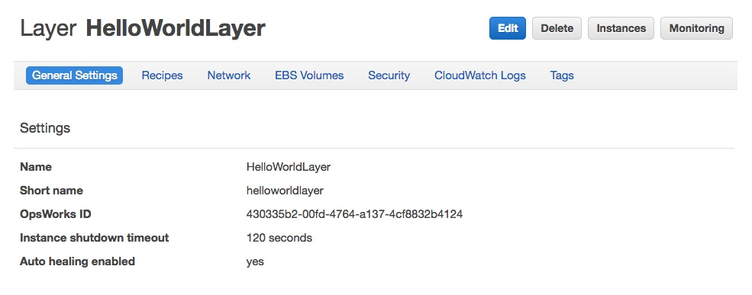
Layers
Add a layer to stack
Defines configuration of instances
Add stack
Under Recipes going to add deploy of nodejs_demo

Slide 14
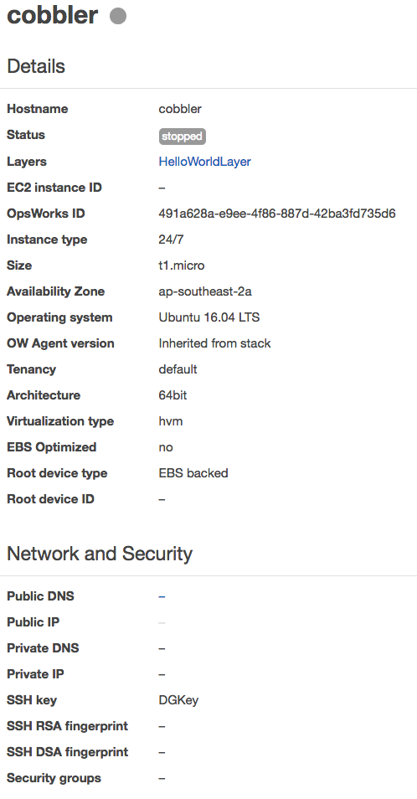
Instances
Instance takes it configuration from process of adding and Layer configuration

Slide 15
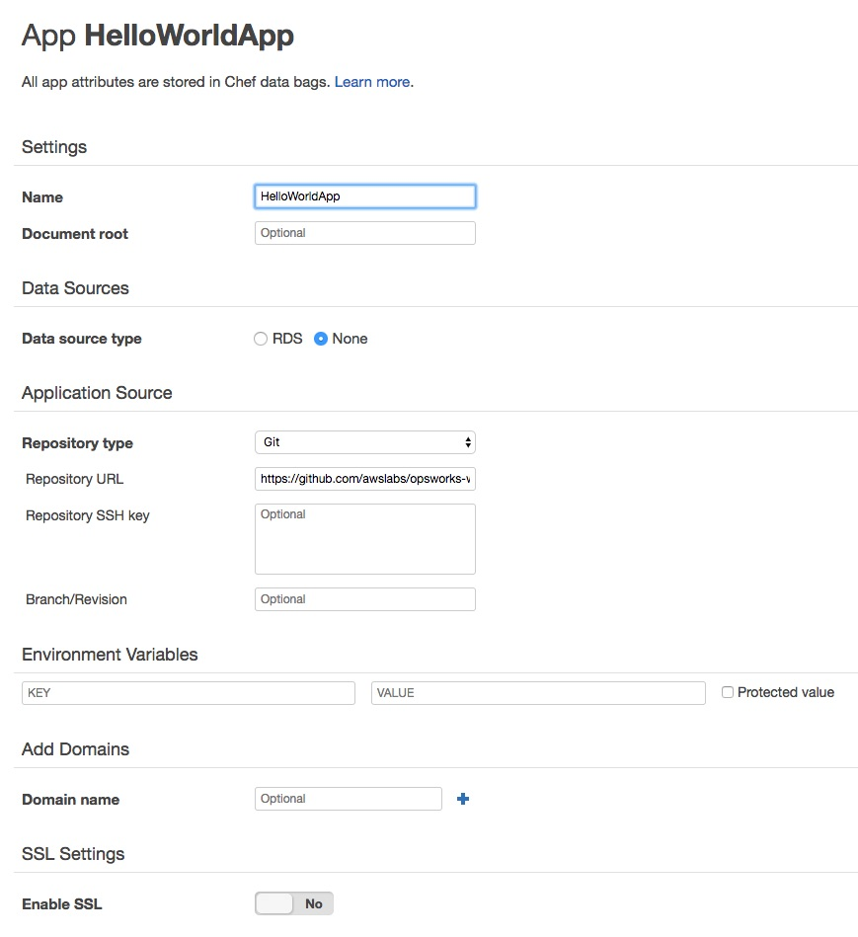
Add application
Configure application – takes deploy recipe from Layer
Can add source code repository
Once set up – can deploy which will install all necessary libraries, code etc and configure it to run

Slide 16
Demo Recipe
app = search(:aws_opsworks_app).first
app_path = "/srv/#{app['shortname']}"
package "git" do
# workaround for:
# WARNING: The following packages cannot be authenticated!
# liberror-perl
# STDERR: E: There are problems and -y was used without --force-yes
options "--force-yes" if node["platform"] == "ubuntu" && node["platform_version"] == "14.04"
end
application app_path do
javascript "4"
environment.update("PORT" => "80")
environment.update(app["environment"])
git app_path do
repository app["app_source"]["url"]
revision app["app_source"]["revision"]
end
link "#{app_path}/server.js" do
to "#{app_path}/index.js"
end
npm_install do
retries 3
retry_delay 10
end
npm_start do
action [:stop, :enable, :start]
end
end
In the nodejs_demo cookbook there are several files
nodejs_demo/recipes/default.rb
nodejs_demo/metadata.json
brings in dependencies:
application_javascript
poise
poise-javascript
poise-languages
poise-service
These are further cookbooks for installing server-side javascript like Node.js

Slide 17
How do you update code?
Code normally kept in source code repository e.g. bitbucket or github
Source code version control allows:
Collaborative development on same code
Managing branches of code for a variety of reasons
Testing new ideas
Developing new features
Developing new versions of code whilst maintaining the current version
Audit trail and blame for who did what when
Allows mistakes to be corrected with reverting back
git allows code deployment and ”continuous integration”

Slide 18
Git and GitHub Basics
Source is kept in a “repository” or “repo”
Copying repo from GitHub or other remote server to local disk is called “cloning”
Updating local files from repo involves a “pull” from remote repo
Updating remote repo from working directory involves a “push”
Main branch of repo is called “master” branch
When a branch is merged into master the process is called a “merge"

Slide 19
Git commands
git init - Create new directory and initialise
git remote add origin /path/to/repository – say where the remote repo is (usually on somewhere like GitHub)
git add . - register files with git
git commit –m “commit message” – commits files that have been added
git push origin master – “origin” the path to repository “master” the branch

Slide 20
Git commands 2
git clone /path/to/repository - creates a working directory with a copy of the repo
git branch new_branch_name – create a branch
git checkout other_branch_name – checkout code using a specific branch

Slide 21
Continuous integration/Continuous Delivery
CI: Process of constantly merging development with a master branch for testing (e.g. on a daily basis)
CD: Automatic deployment of code to internal systems for further testing as soon as committed changes have passed automated tests
Advantages of CI/CD:
Commit frequently to reduce merge issues
Automatically test each commit
Automatically create a production candidate build for each successfully tested commit
Deploy that build to necessary environments for manual testing
Deploy builds that pass manual testing to production

Slide 22
CI/CD How?
Tools that automate CI
Jenkins
Travis CI
Bamboo
GitLab etc.
AWS has various versions of to manage source, build, test and deploy
AWS CodeCommit: Git repositories
AWS CodeBuild: Build, test and package for deployment uses Docker
AWS CodeDeploy:
AWS CodePipeline integrates products for CI/CD

Slide 23
AWS CodeBuild Example
import numbers class HelloWorld: def __init__(self): self.message = 'Hello world!' ''' Given two numbers return True if a > b ''' def isgt(self, a, b): if not isinstance(a, numbers.Number): raise ValueError if not isinstance(b, numbers.Number): raise ValueError if a > b: return True else: return False
Simple Python project HelloWorld
HelloWorld.py

Slide 24
Unit Test
import unittest from HelloWorld import HelloWorld class MyTestCase(unittest.TestCase): def test_default_greeting_set(self): hw = HelloWorld() self.assertEqual(hw.message, 'Hello world!') def test_isgt_lt(self): hw = HelloWorld() self.assertFalse(hw.isgt(3, 4)) def test_isgt_gt(self): hw = HelloWorld() self.assertTrue(hw.isgt(4, 3)) def test_isgt_notnumber(self): hw = HelloWorld() self.assertRaises(ValueError, hw.isgt, "4", "5") # def test_demo(self): # self.fail() if __name__ == '__main__': unittest.main()
HelloWorld_test.py

Slide 25
Build Spec
version: 0.2 phases: build: commands: - echo Build started on `date` - echo Compiling the Python code... - python HelloWorld_test.py post_build: commands: - echo Build completed on `date` artifacts: files: - HelloWorld.py
buildspec.yml

Slide 26
CodeBuild Configuration
Code is put on GitHub – could be elsewhere – S3, Bitbucket etc.
https://github.com/uwacsp/helloworld
Configured to run each time code change is pushed to repository
Build environment
aws/codebuild/python:3.5.2
buildspec.yml is in root directory of source code
Can configure machines and environment to run the build and test – useful if testing databases etc

Slide 27
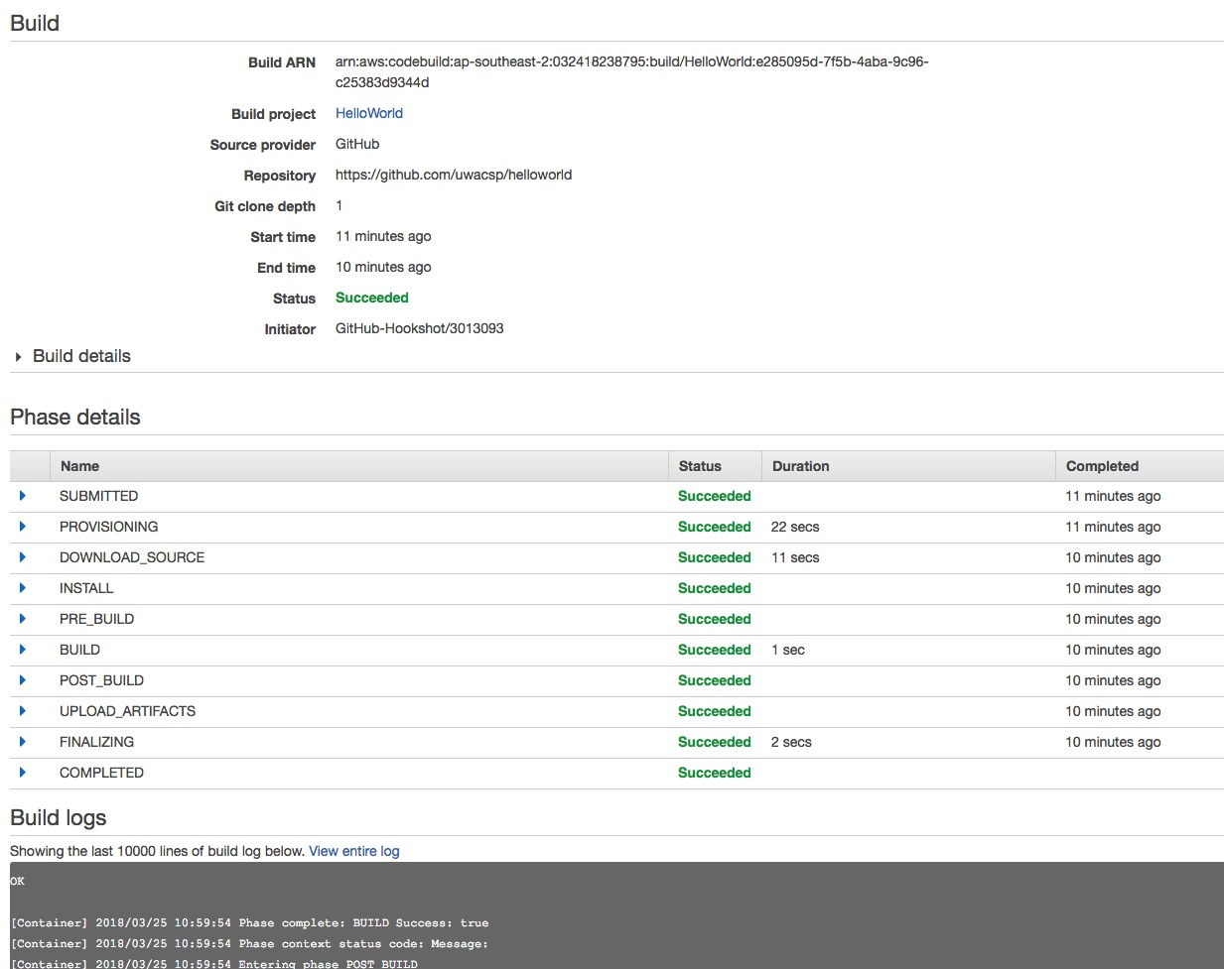
Run build
Run gives details of build and tests run

Slide 28
AWS CodeDeploy
Mechanism for handling the testing and deployment of new code
In-place deployment
Blue/Green Deployment
Blue is active live environment
Green is the new version that can act as a system test environment
Switching between green and blue environments easy and no disruption
Can roll-back

Slide 29
AWS CodeDeploy Example
Process involves defining an application using a particular deployment type
Environment configuration: Auto Scaling group, EC2 instances or On-premises instances
Depends on CloudFormation template for full configuration
Code source: S3 or GitHub
Can send notifications in event of success/failure

